Slide 1
Low-rank Approximation Algorithms
Jiangjiao Xu
02/05/2021

Slide 2
Outline
什么是降维？
为什么要降维？
降维技术有哪些？
目前自己做的一些工作。
个人的一些思考

Slide 3
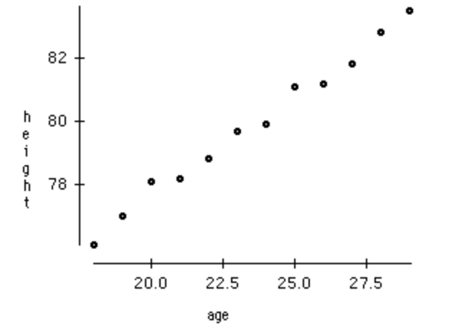
什么是降维
Tremendous amount of data daily.
90% of the data in the world has been generated in the last 3-4 years.
Facebook collects data of what you like, share, post, places you visit, restaurants you like, etc.
Your smartphone apps collect a lot of personal information about you
As data generation and collection keeps increasing, visualizing it and drawing inferences becomes more and more challenging.

Slide 4
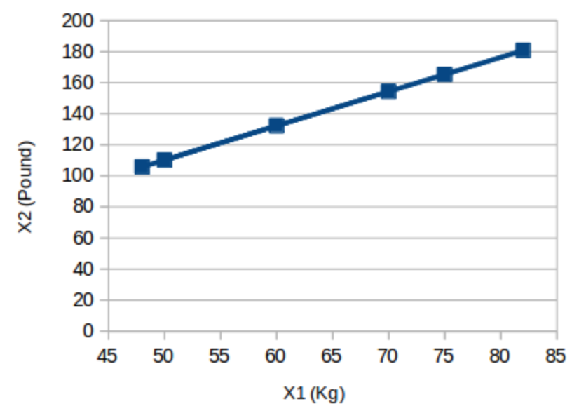

什么是降维
两个变量，但它们传达的信息是一致的，即物体的重量
我们只需要其中一组数据就行。
把二维（x1和x2）压缩到一维（y1）上就行。

Slide 5
为什么要降维
Space required to store the data is reduced.
Less computation/training time.
Some algorithms do not perform well when we have a large dimensions.
It takes care of multicollinearity by removing redundant features.
It helps in visualizing data.

Slide 6
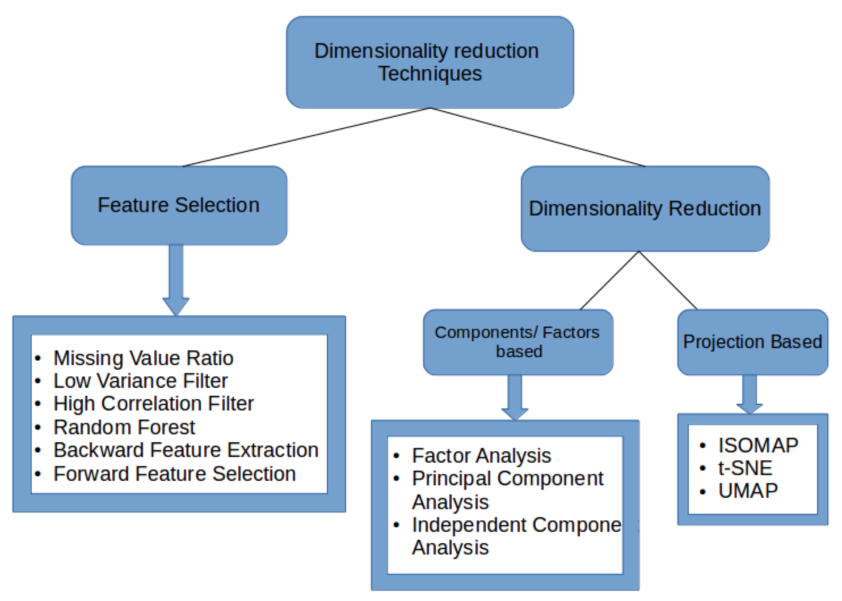
降维技术一览

Slide 7
特征选择 VS 特征提取
特征选择（Feature Selection）:choosing a subset of all the features(the ones more informative)。也就是说，特征选择后的特征是原来特征的一个子集，仅保留原始数据集中最相关的变量。
特征提取（Feature Extraction）: Creating a subset of new features by combinations of the existing features.也就是说，特征抽取后的新特征是原来特征的一个映射。
特征选择和特征抽取有着些许的相似点，这两者达到的效果是一样的，就是试图去减少特征数据集中的属性(或者称为特征)的数目，从而达到降维的作用；但是两者所采用的方式方法却不同：特征抽取的方法主要是通过属性间的关系，如组合不同的属性得新的属性，这样就改变了原来的特征空间；而特征选择的方法是从原始特征数据集中选择出子集，是一种包含的关系，没有更改原始的特征空间。

Slide 8
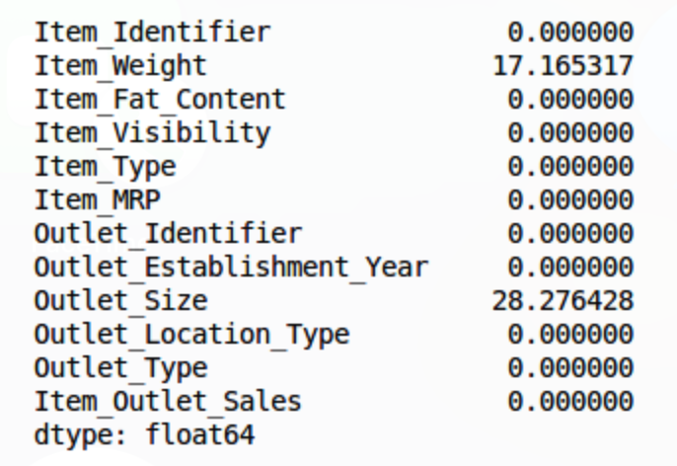
Missing value Ratio
Explore the data first before building model.
While exploring the data, you find that your dataset has some missing values.
Should we impute the missing values or drop the variable?
Set a threshold value.

Slide 9
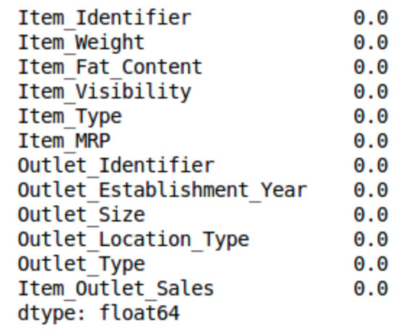
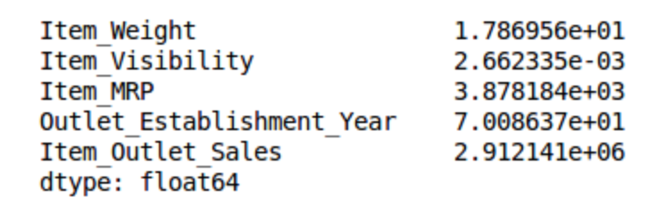
Low Variance Filter
Consider a variable in our dataset where all the observations have the same value, say 1.
Calculate the variance of each variable we are given.
Variables with a low variance will not affect the target variable.

Slide 10
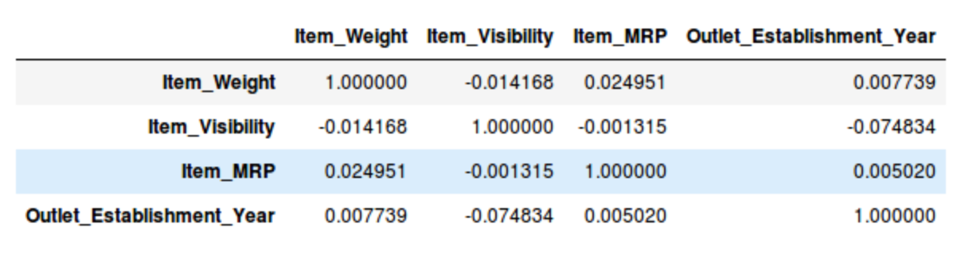
High Correlation Filter
High correlation between two variables means they have similar trends and are likely to carry similar information.
High correlation between two variables means they have similar trends and are likely to carry similar information.
Drop one of the variables。

Slide 11
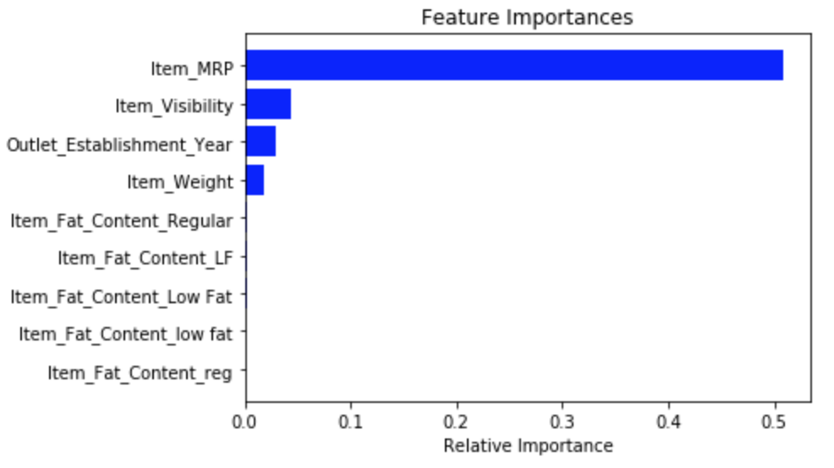
Random Forest
Widely used algorithms for feature selection。
Don’t need to program that separately.
Random Forest (Scikit-Learn Implementation) takes only numeric inputs.
Based on the above graph, we can hand pick the top-most features to reduce the dimensionality in our dataset.

Slide 12
Backward Feature Elimination
We first take all the n variables present in our dataset and train the model using them.
We then calculate the performance of the model.
Now, we compute the performance of the model after eliminating each variable (n times), i.e., we drop one variable every time and train the model on the remaining n-1 variables.
We identify the variable whose removal has produced the smallest (or no) change in the performance of the model, and then drop that variable.
Repeat this process until no variable can be dropped.

Slide 13
Forward Feature Selection
We start with a single feature. Essentially, we train the model n number of times using each feature separately
The variable giving the best performance is selected as the starting variable
Then we repeat this process and add one variable at a time. The variable that produces the highest increase in performance is retained
We repeat this process until no significant improvement is seen in the model’s performance

Slide 14
降维技术一览

Slide 15
因子分析（Factor Analysis）
Suppose we have two variables: Income and Education. These variables will potentially have a high correlation as people with a higher education level tend to have significantly higher income, and vice versa.
Variables are grouped by their correlations, i.e., all variables in a particular group will have a high correlation among themselves, but a low correlation with variables of other group(s).
Each group is known as a factor. These factors are small in number as compared to the original dimensions of the data. However, these factors are difficult to observe.

Slide 16
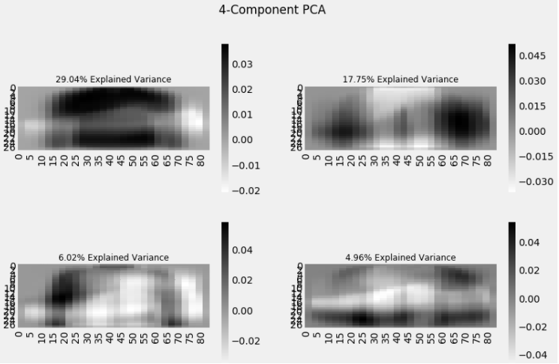
Principal Component Analysis (PCA)
A principal component is a linear combination of the original variables.
Principal components are extracted in such a way that the first principal component explains maximum variance in the dataset.
Second principal component tries to explain the remaining variance in the dataset and is uncorrelated to the first principal component.
Third principal component tries to explain the variance which is not explained by the first two principal components and so on.

Slide 17
矩阵分解
矩阵分解主要是探讨如何将矩阵拆解为数个矩阵的代数运算（包含加法，乘法，点乘等）。
直接处理矩阵没有实际可解释的意义，也不适合大规模的数据处理。
LU矩阵分解，Cholesky分解，QR分解，QZ分解，Polar分解，SVD分解，,Jordan分解, Schur分解 。

Slide 18
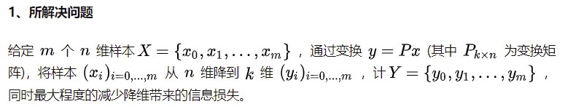
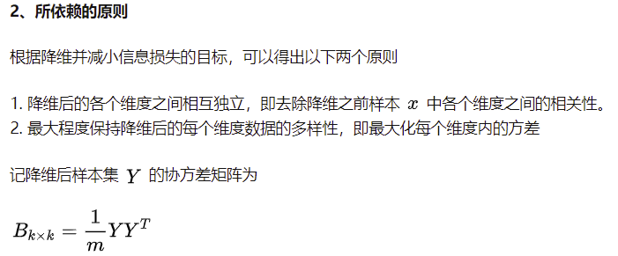
矩阵降维之矩阵分解 PCA

Slide 19
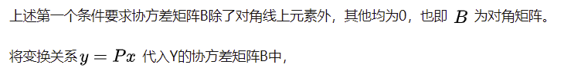
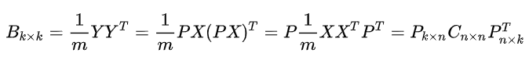
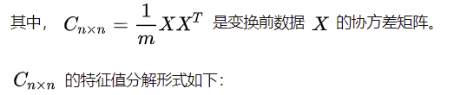
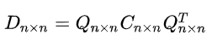
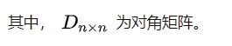
矩阵降维之矩阵分解 PCA
（1）
（2）

Slide 20
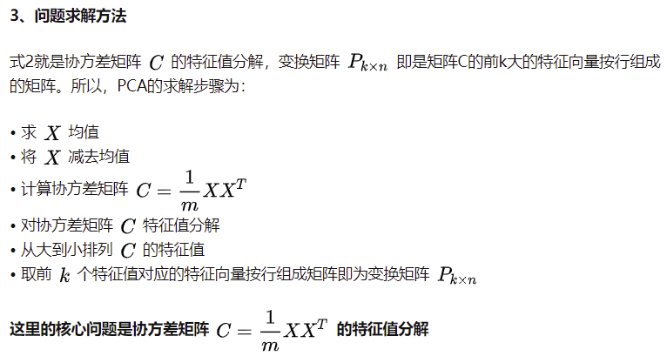
矩阵降维之矩阵分解 PCA

Slide 21
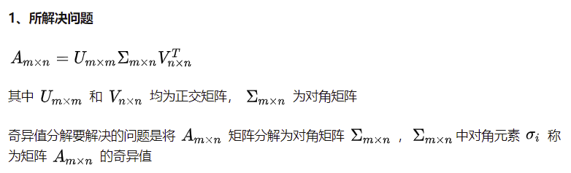
矩阵降维之矩阵分解 SVD
（3）

Slide 22
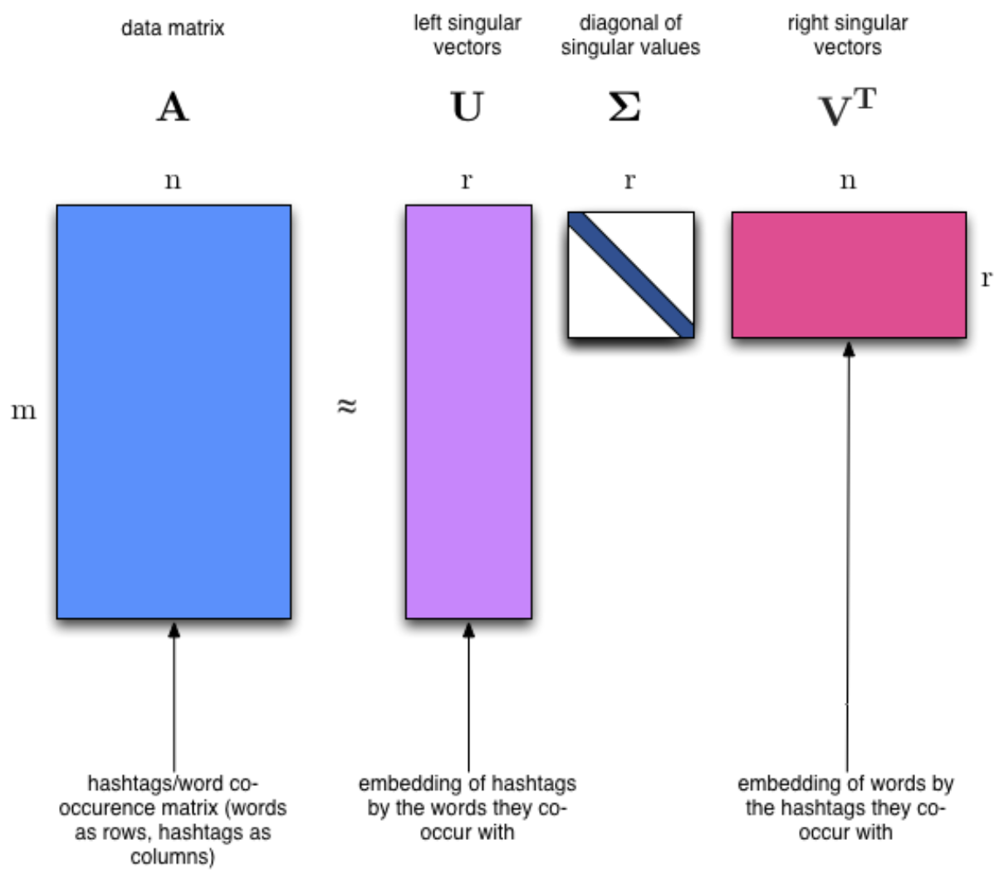
矩阵降维之矩阵分解 SVD

Slide 23
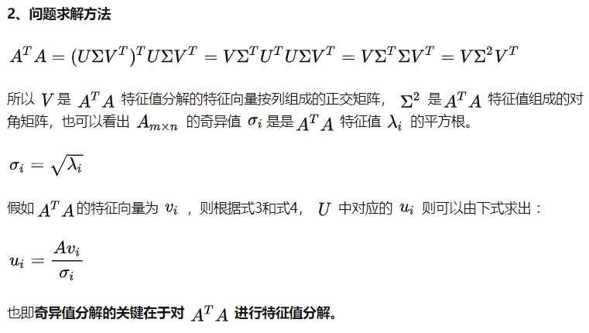
矩阵降维之矩阵分解 SVD
（4）
（5）

Slide 24
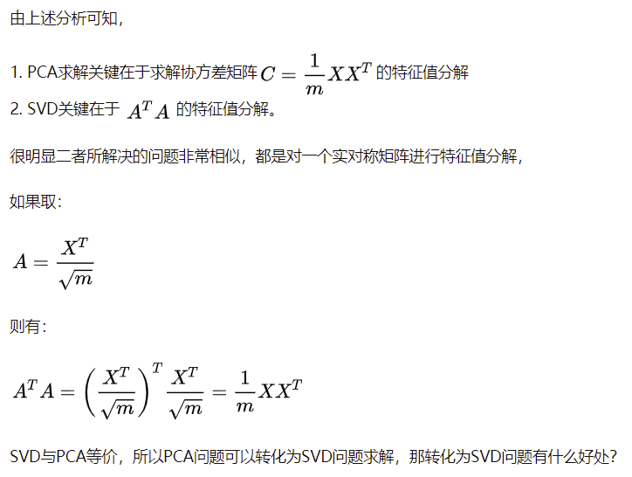
PCA VS SVD
（4）
（5）

Slide 25
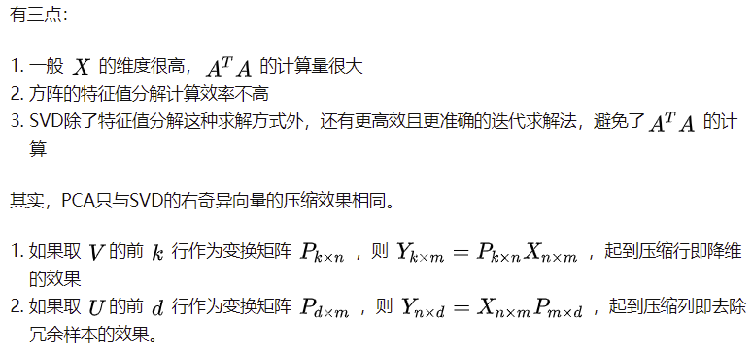
PCA VS SVD

Slide 26
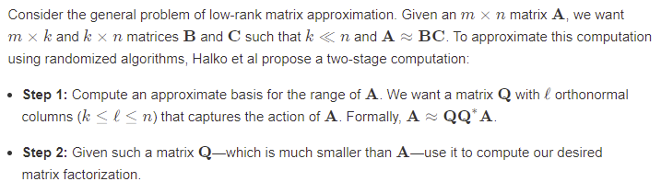
Randomized SVD

Slide 27
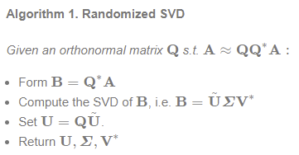
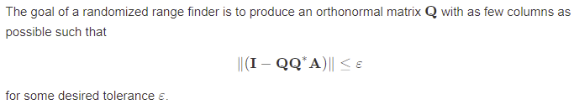
Randomized SVD

Slide 28
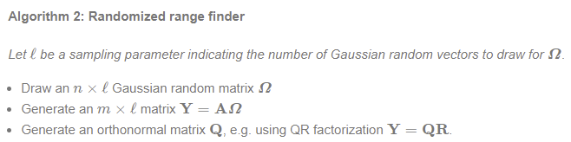
Randomized SVD
To find an orthonormal basis for these vectors gives us our desired Q. This scheme is formally described in Algorithm 2.

Slide 29
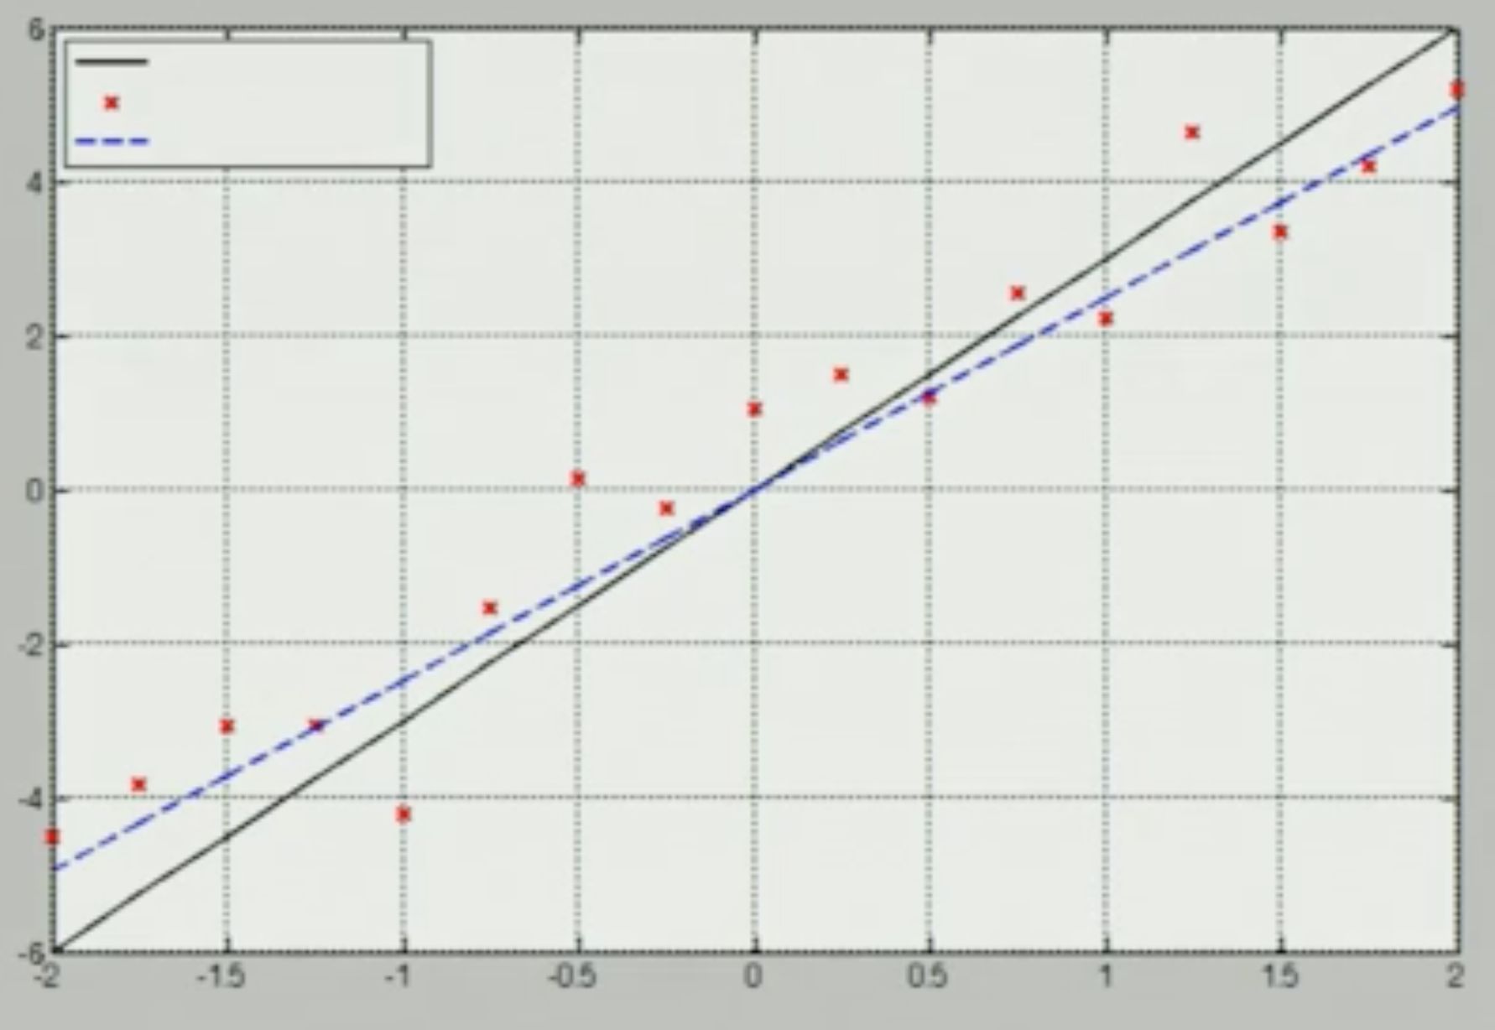
SVD method
ax=b
U*S*V^T x = b
a = [-1:.1:2]’
b=a*x+randn(size(a))
[U, S, V] = svd(a)
x = V*inv(s)*U*b

Slide 30
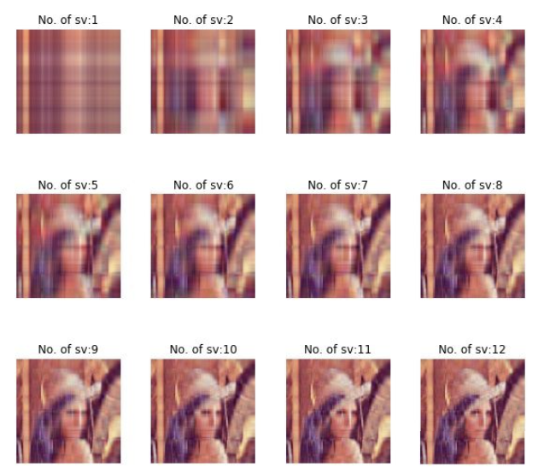
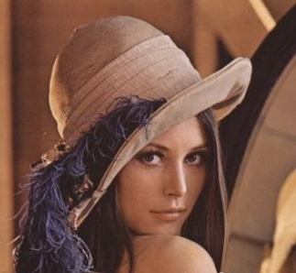
SVD分解实例

Slide 31
Independent Component Analysis (ICA)
Based on information-theory.
One of the most widely used dimensionality reduction techniques
Major difference between PCA and ICA is that PCA looks for uncorrelated factors while ICA looks for independent factors.
If two variables are uncorrelated, it means there is no linear relation between them.
If they are independent, it means they are not dependent on other variables.

Slide 32
Other Techniques
ISOMAP is a nonlinear dimensionality reduction method.
t- Distributed Stochastic Neighbor Embedding (t-SNE).
Uniform Manifold Approximation and Projection (UMAP).

Slide 33
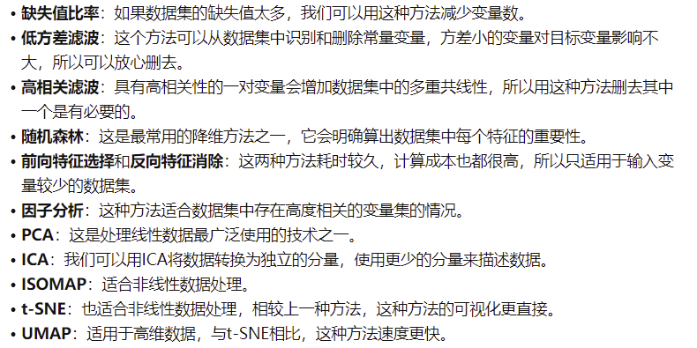
12种降维方法的总结

Slide 34
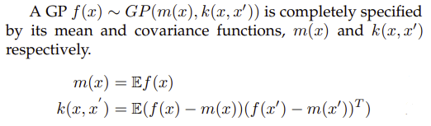
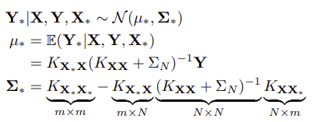
Gaussian Processes

Slide 35
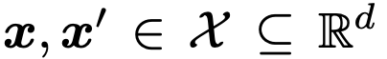
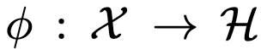
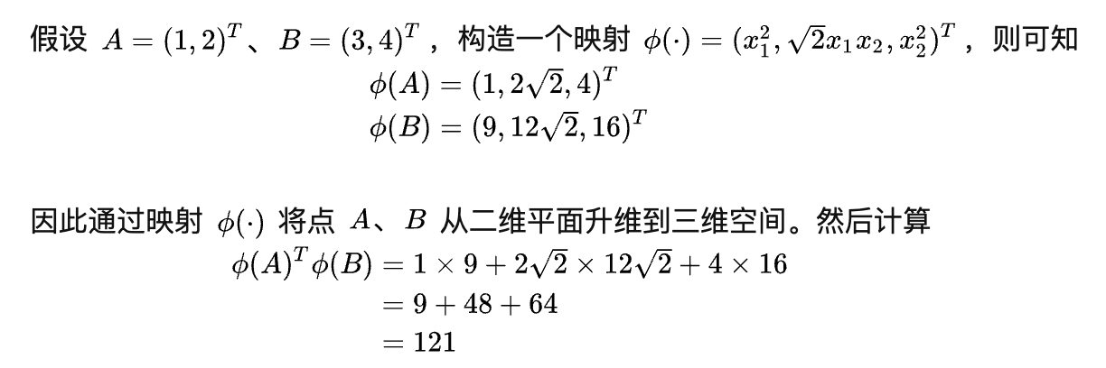
Kernel Trick
什么是kernel trick
Kernel function

Slide 36
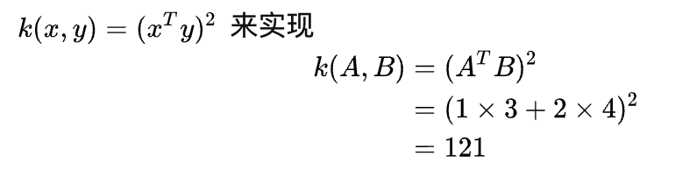
Kernel Trick 简单的例子
为什么要这么做？
避免了维度灾难，也就是说高维空间中的运算计算量很大呈指数级别复杂度，难以解决；低维空间中的运算计算量很小但是两者的最终结果是一致的。例如上述计算过程，高维空间中执行了11次乘法运算、2次根号运算和2次加法运算，低维空间中仅执行了3次乘法运算和1次加法运算，要知道这才二维空间映射到三维空间如果映射到n维空间呢？

Slide 37
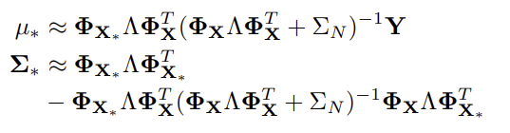
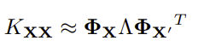
Gaussian Processes

Slide 38
Gaussian Processes
 | Normal | Low-rank
140 Data Points | 0.102s | 0.088s
2000 Data Points | 44s | 18s

Slide 39
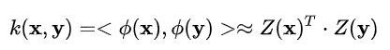
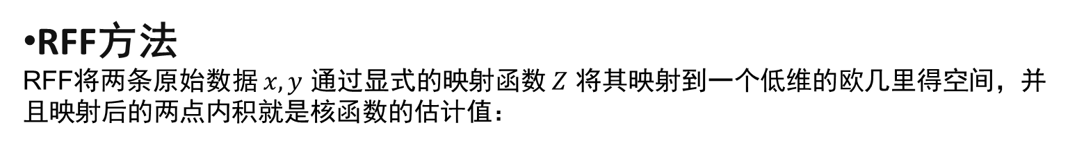
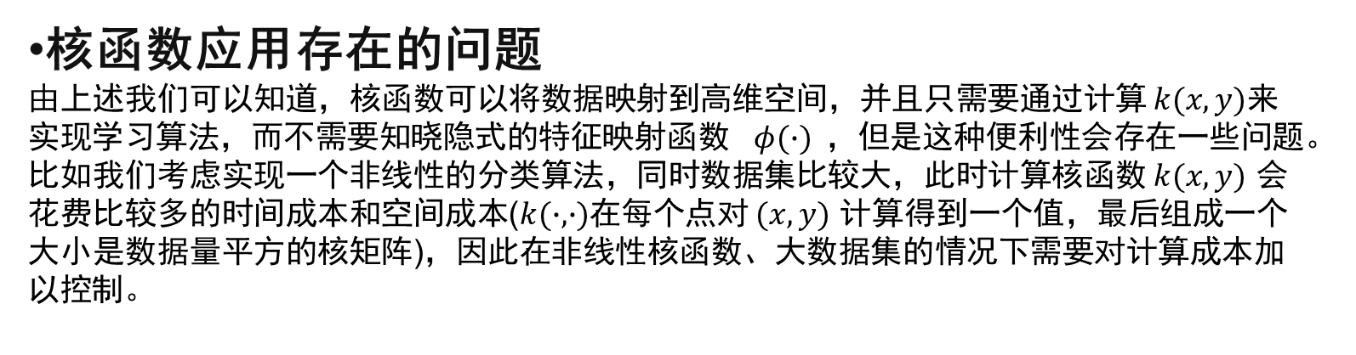
随机傅里叶特征方法(RFF)
核函数应用存在的问题
由上述我们可以知道，核函数可以将数据映射到高维空间，并且只需要通过计算 $k(x,y)$来实现学习算法，而不需要知晓隐式的特征映射函数 $φ(∙)$，但是这种便利性会存在一些问题。比如我们考虑实现一个非线性的分类算法，同时数据集比较大，此时计算核函数 $k(x,y)$ 会花费比较多的时间成本和空间成本($k(∙,∙)$在每个点对 $(x,y)$ 计算得到一个值，最后组成一个大小是数据量平方的核矩阵)，因此在非线性核函数、大数据集的情况下需要对计算成本加以控制。
RFF方法
RFF将两条原始数据 $x,y$ 通过显式的映射函数 $Z$ 将其映射到一个低维的欧几里得空间，并且映射后的两点内积就是核函数的估计值：

Slide 40
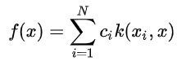
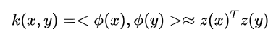
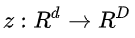
随机傅里叶特征方法(RFF)
如果我们使用核方法来预测测试集的样本$x$，比如核岭回归，我们需要计算：
我们就需要$O(Nd)$计算量，其中N是样本量，d是x的维度大小。当样本量特别大的时候，这个复杂度是不可接受的。那我们能不能找到一个近似的方法，使得
为了找到这么个z，我们先介绍一个在调和分析中，针对一类shift-invariant kernel的重要定理

Slide 41
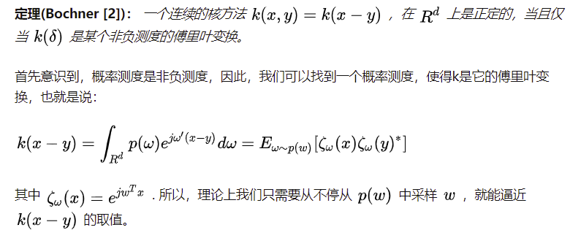
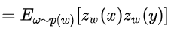
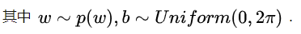
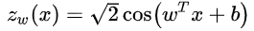
随机傅里叶特征方法(RFF)

Slide 42
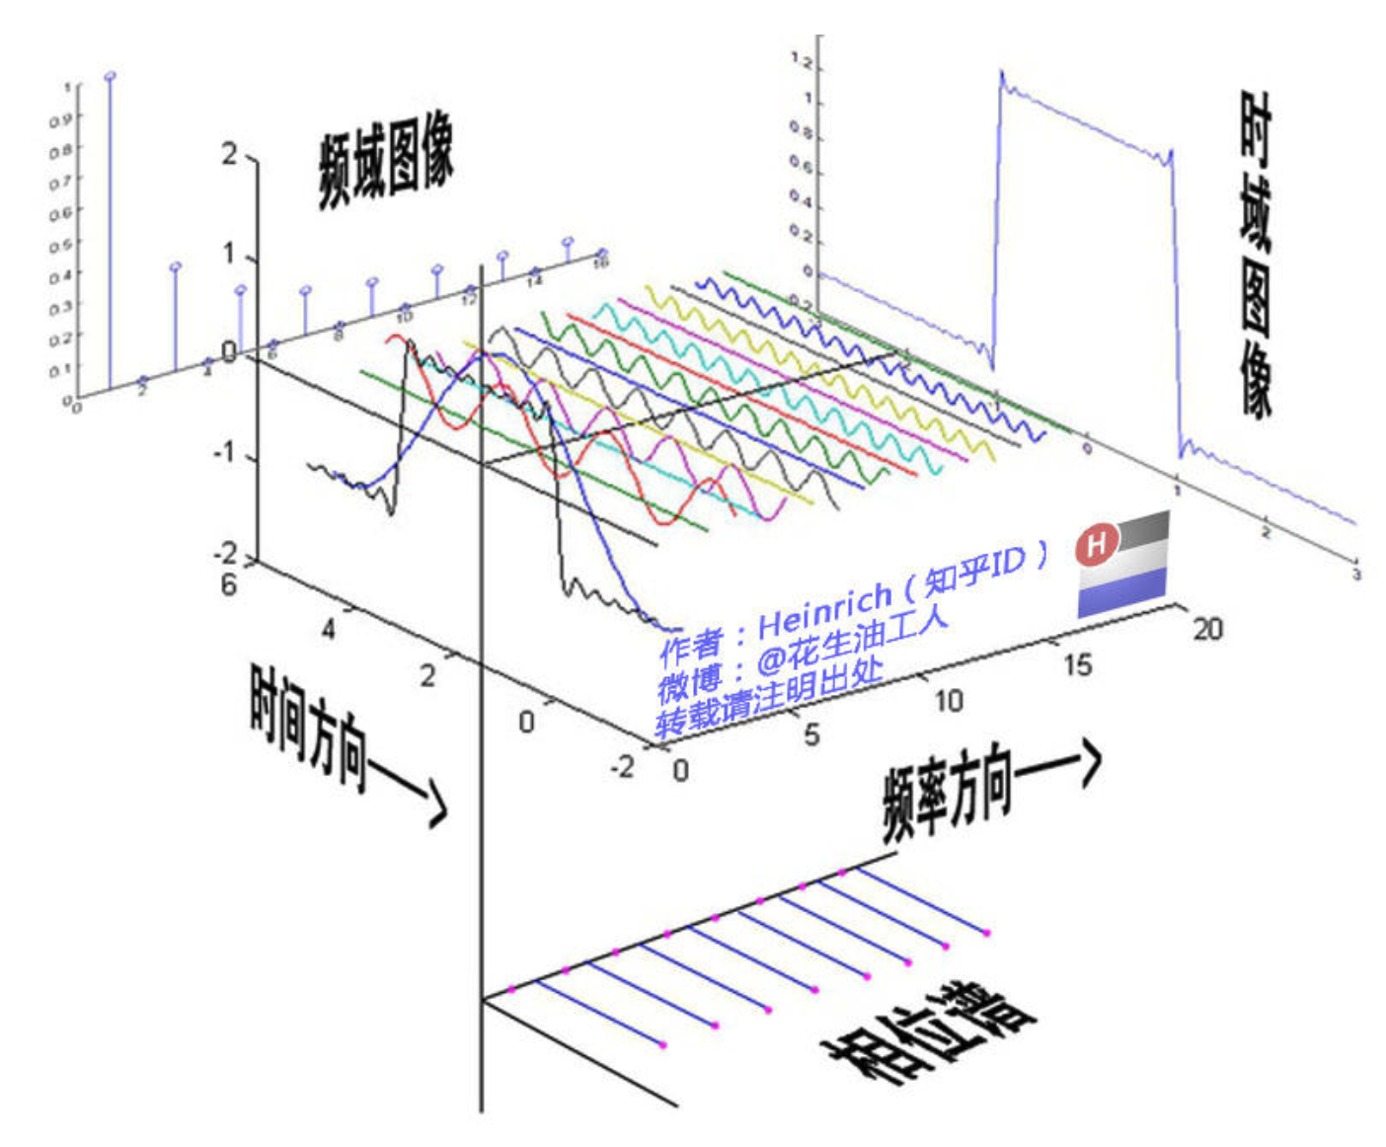
傅里叶变换

Slide 43
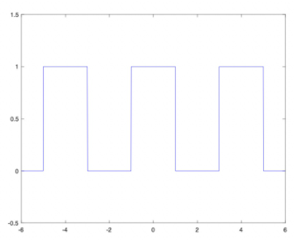




傅里叶变换

Slide 44

随机傅里叶特征方法(RFF)

Slide 45

随机傅里叶特征方法(RFF)

Slide 46
随机傅里叶特征方法(RFF)
 | Kernel | RFF | Error
140 Data Points | 0.09s | 0.05s | 4.96E-03
2000 Data Points | 1.35s | 0.33s | 4.08E-03

Slide 47
思考和总结
Balance近似矩阵和Error之间的关系。对于RFF的话，我们就需要对D进行选择来balance速度和error。
对于数据量的大小和应用的场景来决定需不需要降维，如何决定降维的必要性，比如对于实时场景，对速度需求很高，或者就是数据量很大，每个样本的维度都很高的情况下，核函数的计算量很高。
目前对于RFF的应用场景前面也提到了，只适合于移位不变性核函数，所以需要考虑对于别的核函数，如果做RFF的降维，这是我们后面需要考虑的问题。

